Slide 1
Data Types in Python
Unit-3&4

Slide 2
Data types in Python
Every value in Python has a datatype. Since everything is an object in Python programming, data types are actually classes and variables are instance (object) of these classes. Some of the datatypes in Python are:-
Python Numbers
Python Strings
Python List
Python Tuple
Python Dictionary

Slide 3
Number Data Type in Python
Python supports integers, floating point numbers and complex numbers. They are defined as int, float and complex class in Python.
Integers and floating points are separated by the presence or absence of a decimal point. 5 is integer whereas 5.0 is a floating point number.
Complex numbers are written in the form, x + yj, where x is the real part and y is the imaginary part.

Slide 4
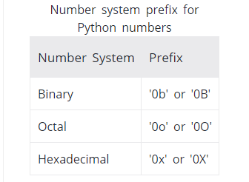
Number Data Type in Python
We can use the type() function to know which class a variable or a value belongs to and isinstance() function to check if it belongs to a particular class.

Slide 5
Python List
List is an ordered sequence of items. All the items in a list do not need to be of the same type.
List is a collection which is ordered and changeable. It allows duplicate members.
In Python programming, a list is created by placing all the items (elements) inside a square bracket [ ], separated by commas.
It can have any number of items and they may be of different types (integer, float, string etc.).
Lists are mutable, and hence, they can be altered even after their creation.
We can use the index operator [] to access an item in a list. Index starts from 0. So, a list having 5 elements will have index from 0 to 4.

Slide 6
Python List
e.g.
# empty list
my_list = []
# list of integers
my_list = [1, 2, 3]
# list with mixed datatypes
my_list = [1, "Hello", 3.4]

Slide 7
Python List
Also, a list can even have another list as an item. This is called nested list.
e.g.
# nested list
my_list = ["mouse", [8, 4, 6], ['a']]

Slide 8
Adding elements to a List
Using append():
  Elements can be added to the List by using built-in append() function.
  Only one element at a time can be added to the list by using append() method, for addition of multiple elements with the append() method, loops are used.

Slide 9
Adding elements to a List
Using insert() method:
  append() method only works for addition of elements at the end of the List, for addition of element at the desired position, insert() method is used.
  Unlike append() which takes only one argument, insert() method requires two arguments(position, value).

Slide 10
Adding elements to a List
Using extend() method:
  extend(), this method is used to add multiple elements at the same time at the end of the list.

Slide 11
Access elements from a list
We can use the index operator [] to access an item in a list. Index starts from 0. So, a list having 5 elements will have index from 0 to 4.
Trying to access an element other that this will raise an IndexError. The index must be an integer. We can't use float or other types, this will result into TypeError.
Nested list are accessed using nested indexing.

Slide 12
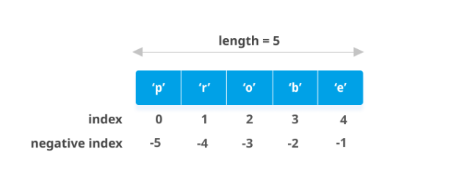
Access elements from a list
Negative Indexing:
  In Python, negative sequence indexes represent positions from the end of the array.
  Negative indexing means beginning from the end, -1 refers to the last item, -2 refers to the second last item etc
E.g. my_list = ['p','r','o','b','e']

Slide 13
Removing elements from the List
Using remove() method:
  Elements can be removed from the List by using built-in remove() function but an Error arises if element doesn’t exist in the set.
  Remove() method only removes one element at a time, to remove range of elements, iterator is used. remove() method is used to remove the given item.
  If a list contains duplicate elements, the remove() method only removes the first matching element.
  The syntax of the remove() method is:
    list.remove(element)

Slide 14
Removing elements from the List
The syntax of the pop() method is:
list.pop(index)
The pop() method takes a single argument (index).
The argument passed to the method is optional. If not passed, the default index -1 is passed as an argument (index of the last item).

Slide 15
Removing elements from the List
del[a : b] :-
  This method deletes all the elements in range starting from index ‘a’ till ‘b’ mentioned in arguments.
  a=[1,2,3,4,5]
  del a[0:3]
  print(a)

Slide 16
Slicing of a List
To print a specific range of elements from the list, we use Slice operation. Slice operation is performed on Lists with the use of colon(:).
To print elements from beginning to a range use [:Index],
to print elements from end use [:-Index],
to print elements from specific Index till the end use [Index:],
to print elements within a range, use [Start Index:End Index] and
to print whole List with the use of slicing operation, use [:].
Further, to print whole List in reverse order, use [::-1].

Slide 17
List Methods in Python
len() :- This function returns the length of list.
min() :- This function returns the minimum element of list.
max() :- This function returns the maximum element of list.
print (len(list))
print (min(list))
print (max(list))

Slide 18
List Methods in Python
count() :- This function counts the number of occurrences of elements in list.
print (lis.count(3))
sum() : Calculates sum of all the elements of List.
Syntax: sum(List)
length:Calculates total length of List.
Syntax:len(list_name)

Slide 19
Tuple in Python
A Tuple is a collection of Python objects separated by commas.
A tuple in Python is similar to a list. The difference between the two is that we cannot change the elements of a tuple once it is assigned whereas, in a list, elements can be changed i.e. a tuple is immutable unlike lists which are mutable.

Slide 20
Creating a Tuple
A tuple is created by placing all the items (elements) inside parentheses (), separated by commas. The parentheses are optional, however, it is a good practice to use them.
A tuple can have any number of items and they may be of different types (integer, float, list, string, etc.).

Slide 21
Creating a Tuple
A tuple can also be created without using parentheses. This is known as tuple packing.
Packing and Unpacking a Tuple : In Python there is a very powerful tuple assignment feature that assigns right hand side of values into left hand side. In other way it is called unpacking of a tuple of values into a variable. In packing, we put values into a new tuple while in unpacking we extract those values into a single variable.
In unpacking of tuple number of variables on left hand side should be equal to number of values in given tuple.

Slide 22
Creating a tuple with one element
Having one element within parentheses is not enough. We will need a trailing comma to indicate that it is, in fact, a tuple.

Slide 23
Access Tuple Elements
We can use the index operator [] to access an item in a tuple where the index starts from 0.
So, a tuple having 6 elements will have indices from 0 to 5.
Python allows negative indexing for its sequences.
The index of -1 refers to the last item, -2 to the second last item and so on.

Slide 24
Slicing
We can access a range of items in a tuple by using the slicing operator - colon ":".
my_tuple = ('p','r','o','g','r','a','m','i','z')
# elements 2nd to 4th
#Output: ('r', 'o', 'g')
print(my_tuple[1:4])

Slide 25
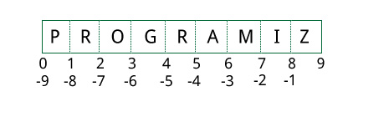
Slicing
Slicing can be best visualized by considering the index to be between the elements as shown below. So if we want to access a range, we need the index that will slice the portion from the tuple.

Slide 26
Changing a Tuple
Unlike lists, tuples are immutable.
This means that elements of a tuple cannot be changed once it has been assigned. But, if the element is itself a mutable datatype like list, its nested items can be changed.
We can also assign a tuple to different values (reassignment).

Slide 27
Mutable vs Immutable i.e. (List vs Tuple)
a variable is nothing but a reference to the actual python object in memory.
The variable itself is not the object.

Slide 28
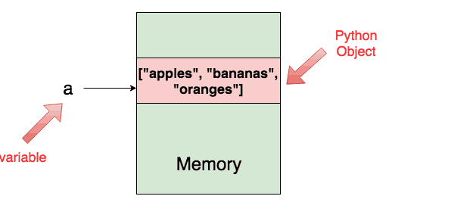
Variable and Python object
a = ["apples", "bananas", "oranges"]
When you do this, a python object of type list is created in the memory and the variable a refers to this object by holding its location in memory.

Slide 29
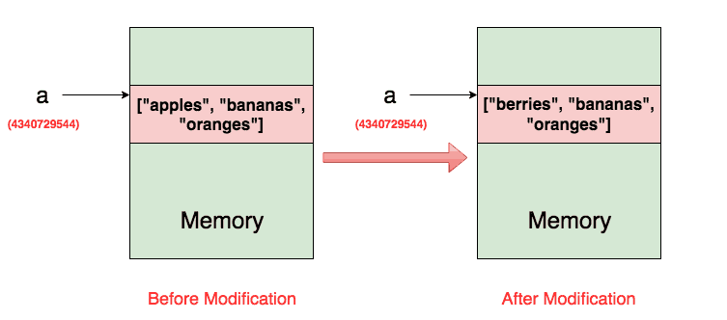
In case of List

Slide 30
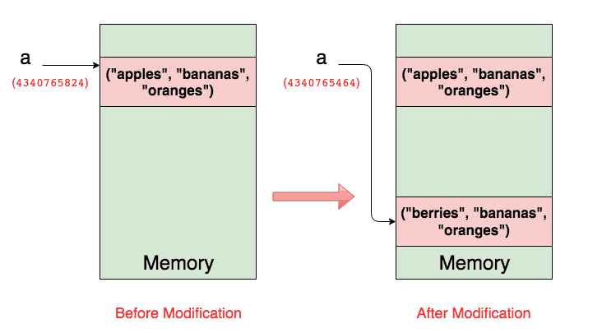
In Case of Tuple

Slide 31
Variables don’t have types instead they are just labels in Python. It is the value which gets associated with a type. Hence, the same variable, the label can refer values of different Python data types.

Slide 32
Dictionary
A dictionary in Python is an unordered collection of key-value pairs. It’s a built-in mapping type in Python where keys map to values.
The dictionary solves the problem of efficiently storing a large data set. Python has made the dictionary object highly optimized for retrieving data.

Slide 33
Creating a Dictionary
Python syntax for creating dictionaries use braces {} where each item appears as a pair of keys and values.
While values can be of any data type and can repeat, keys must be of immutable type (string, number or tuple with immutable elements) and must be unique.
we can also create a dictionary using the built-in function dict().

Slide 34
Accessing elements from a dictionary
While indexing is used with other container types to access values, dictionary uses keys. Key can be used either inside square brackets or with the get() method.
The difference while using get() is that it returns None instead of KeyError, if the key is not found.

Slide 35
Changing/ Adding elements in a dictionary
Dictionary are mutable. We can add new items or change the value of existing items using assignment operator.
If the key is already present, value gets updated, else a new key: value pair is added to the dictionary.

Slide 36
Removing elements from dictionary
We can remove a particular item in a dictionary by using the method pop(). This method removes as item with the provided key and returns the value.
  name of the dictionary.pop(key)
The method, popitem() can be used to remove and return an arbitrary item (key, value) form the dictionary.
  name of the dictionary.popitem()

Slide 37
Removing elements from dictionary
All the items can be removed at once using the clear() method.
  Name of the dictionary.clear()
We can also use the del keyword to remove individual items or the entire dictionary itself.
  del name of the dictionary[key]
  Del name of the dictionary

Slide 38
Loop Control Statements
Loop control statements can be used to alter or control the flow of loop execution based on specific conditions.
In Python, we have following loop control statements:
    Break Statement
    Continue Statement
    Pass Statement

