Slide 1
Diffraction
Bending of light around a corner or wedge so as to enter in the region of geometrical shadow

Slide 2
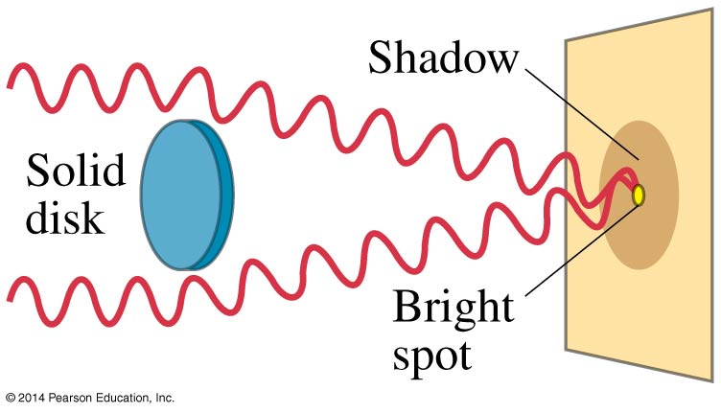
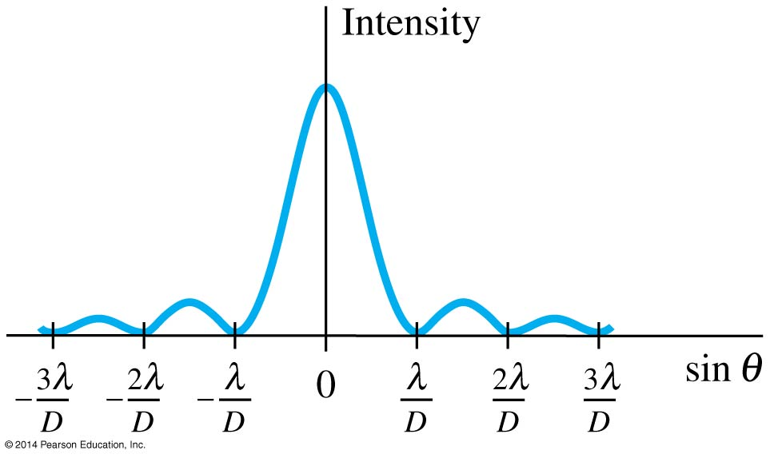
Diffraction by a Single Slit
Light diffracts around a single slit or obstacle with size comparable to it’s wavelength and enters in region of geometrical shadow
The resulting pattern of light and dark stripes is called a diffraction pattern.
This pattern arises because every point along a slit behaves as secondary source and create wavelets that interfere with each other.
Condition for minima of the single-slit diffraction pattern occur when

Slide 3
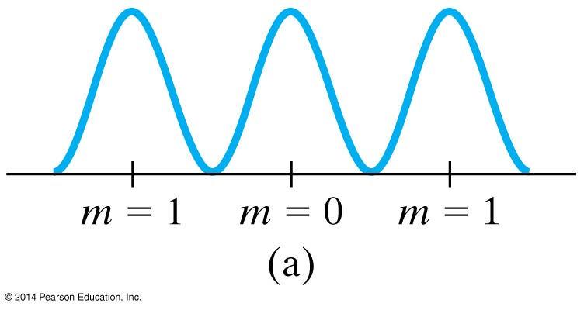
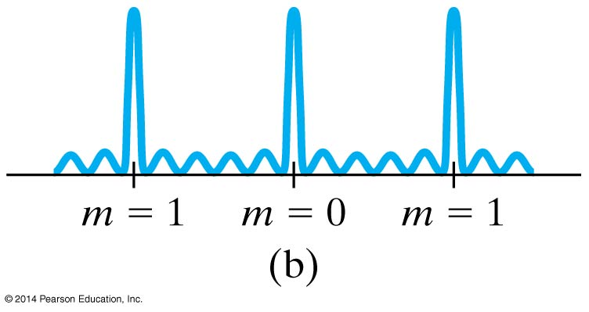
Diffraction Grating
It consists of a large number of equally spaced narrow slits or lines. A transmission grating has slits, while a reflection grating has lines that reflect light.
With more lines or slits, the peaks become narrow.

Slide 4
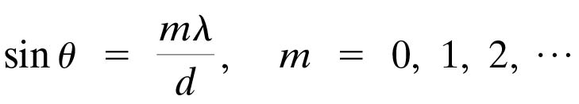
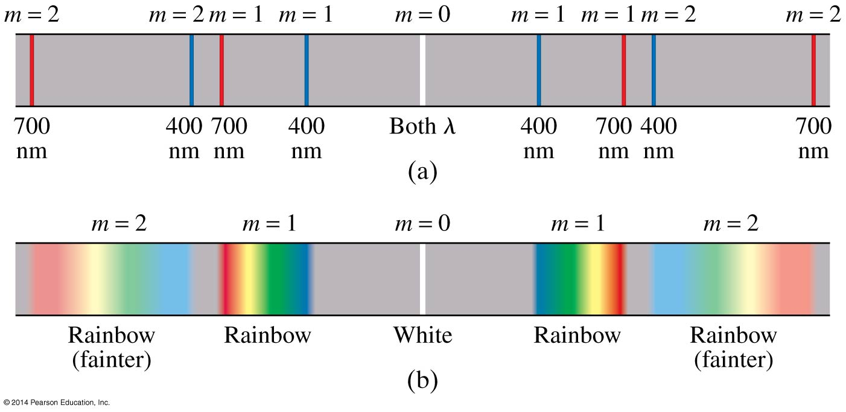
Diffraction Grating
The condition for maxima of the diffraction pattern are
(24-4)

Slide 5
Summary
Light bends around obstacles and openings in its path, yielding diffraction patterns
Light passing through a narrow slit will produce a central bright maximum of width

